Slide 1
INSURANCE IN TIMES OF CLIMATE CHANGE Recent Cyclonic Events in the USA
ASIA PACIFIC INSURANCE CONFERENCE
Raffles City Convention Centre, Singapore
OCTOBER 17-20 2017
BY
Richard K. Traub
Traub Lieberman Straus & Shrewsberry
Notes:
Humanity is facing a challenge unlike any we’ve had to confront. We are in an unprecedented period of change. (David Suzuki – celebrity scientist and alarmist).
“We are simply running out of time” – Greenpeace Spokesman
There is a simple truth. There is climate change. Lets look at some recent cyclonic events impacting the Atlantic region

Slide 2
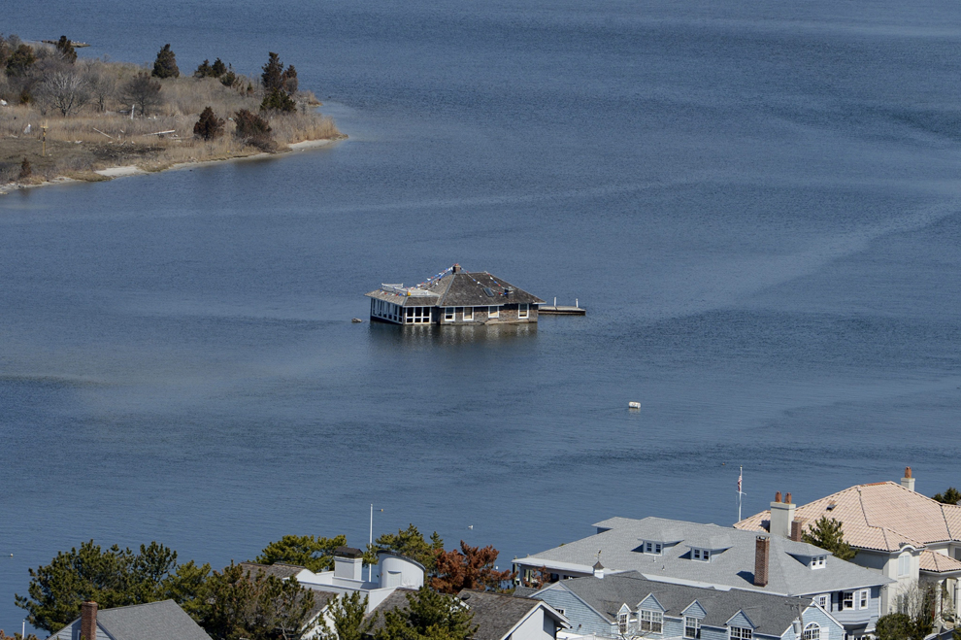
This is not a house boat – Claimed wind damage

Slide 3
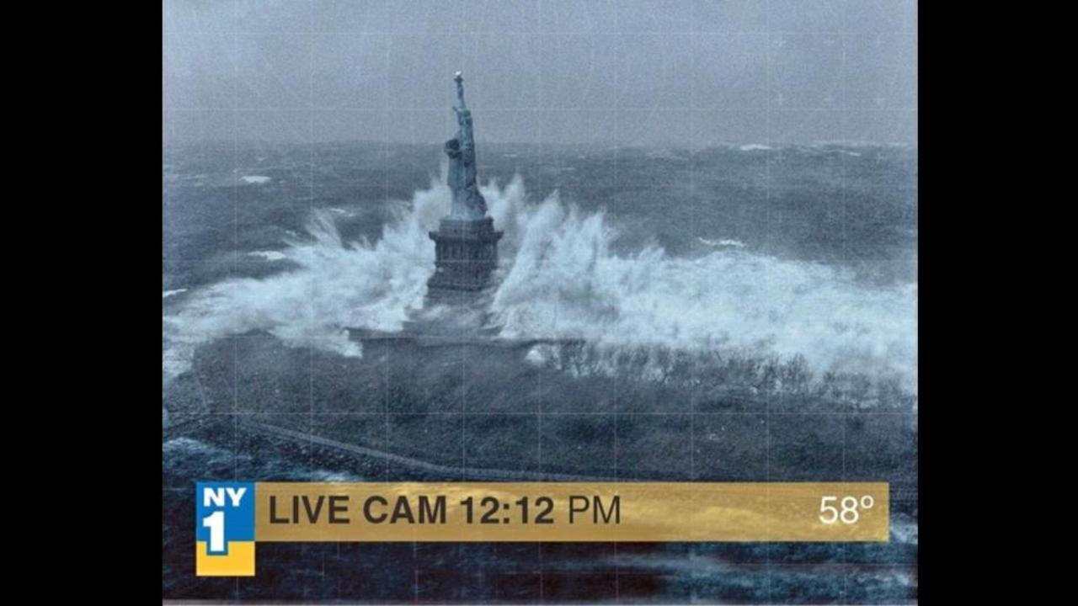
Notes:
Sandy - Lady Liberty survived

Slide 4
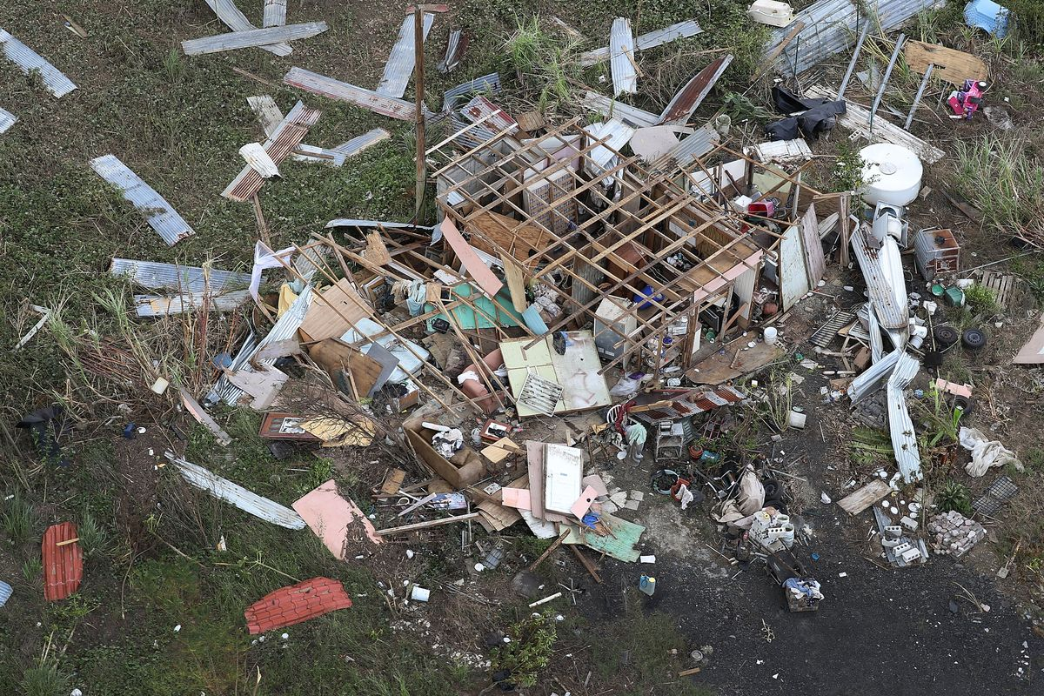
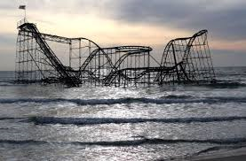
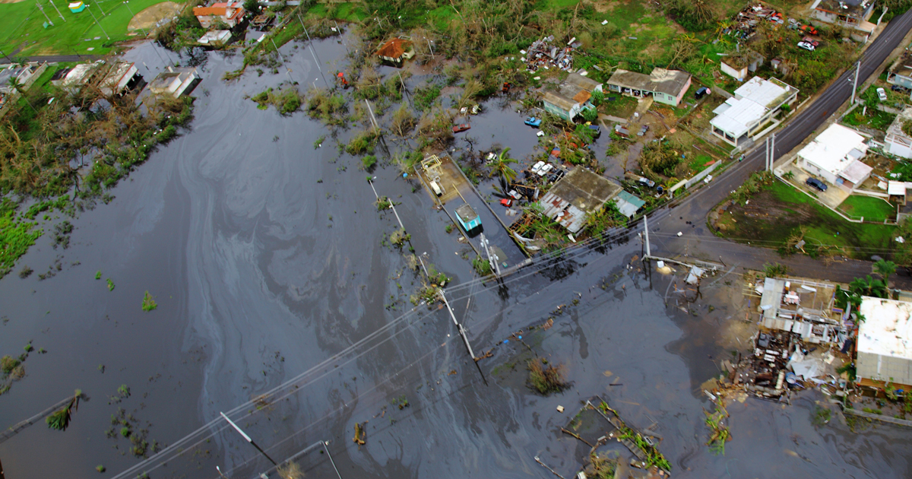
Notes:
Maria and Sandy

Slide 5
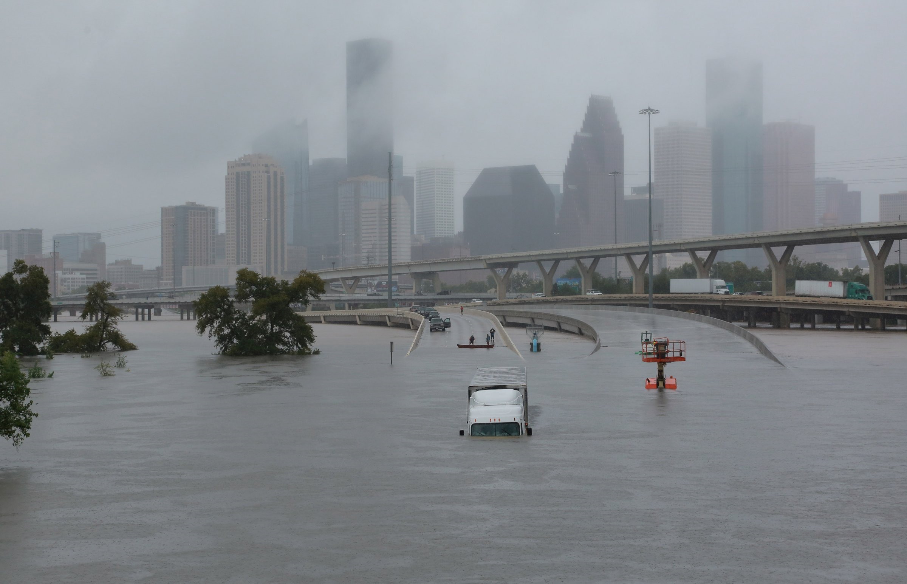
Notes:
Harvey - Houston

Slide 6
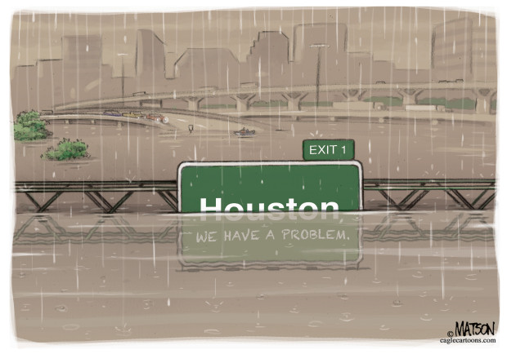

Slide 7
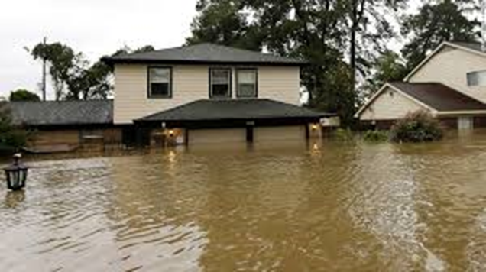
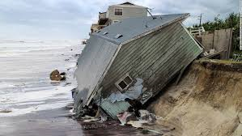
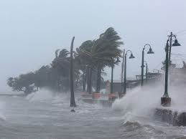
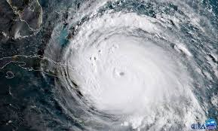
Notes:
Top Left – Harvey. Other 3, Irma

Slide 8
Cyclonic Events in the Atlantic Region
4 Hurricanes in recent weeks (Harvey, Irma, Maria, Nate).
3 of them major, all in hurricane prone areas.
Was it CO2 driven or Circumstance?
Harvey – did cool weather actually contribute?
Irma – 50 miles north. Did CO2 push it to Cuba?

Slide 9
Impact of CO2 – Historical Factors
Did CO2 cause the water to be warmer?
Rank | Hurricane | Season | Landfall Pressure
1 | Labor Day | 1935 | 892 mbar
2 | Gilbert | 1988 | 898 mbar
3 | Camille | 1969 | 900 mbar
4 | Dean | 2007 | 905 mbar
5 | Cuba | 1924 | 910 mbar
6 | Janet | 1955 | 914 mbar
7 | Irma | 2017 | 914 mbar
8 | Maria | 2017 | 917 mbar
9 | Cuba | 1932 | 918 mbar
10 | Katrina | 2005 | 920 mbar

Slide 10
Harvey vs. Other Severe Storms
Rank | Storm Name | Wind (Knots) | Pressure (mb) | Category
1 | 1935 Labor Day | 160 | 892 | 5
2 | 1969 Camille | 150 | 900 | 5
3 | 1992 Andrew | 145 | 922 | 5
4 | 1886 Indianola | 130 | 925 | 4
5 | 1919 Florida Keys | 130 | 927 | 4
6 | 1928 Lake Okeechobee | 125 | 929 | 4
7 | 1926 Great Miami | 125 | 930 | 4
8 | 1960 Donna | 125 | 930 | 4
9 | 1961 Carla | 125 | 931 | 4
10 | 1916 Texas Hurricane | 115 | 932 | 4
11 | 1989 Hugo | 120 | 934 | 4
12 | 1932 Freeport | 130 | 935 | 4
13 | 1900 Galveston | 120 | 936 | 4
14 | 1898 Georgia/ 1954 Hazel; 2017 Harvey | 115 | 938 | 4
17 | 1915 Galveston; 1948 Florida Hurricane | 115 | 940 | 4
19 | 2004 Charley | 130 | 941 | 4
20 | 1947 Fort Lauderdale | 115 | 943 | 4

Slide 11
Notes:
While my focus today is Atlantic cyclonic events, to analyze this question, we must look for this answer, to global tropical cyclone activity. In fact, global cyclonic activity has fallen. That oddity can be extended to the Ice Caps as well. The northern ice cap is indeed well below normal, but since the Pacific Ocean turned to its colder cycle, the western part of the cap around Alaska has experienced growth. The denialists predict that the Northern ice cap will recover once the current warm cycle of the Atlantic ends, which should be in about 10 years. Another point to note is that Southern ice hit a record high in 2015 in its cold season. Indeed, our oceans hold 1,000 times the energy as does the atmosphere and each ocean, goes through extended periods of warming and cooling.
The warming that occurred from the late 1970’s to the mid ‘90s correlates almost 1 to 1 with the Pacific warming. This massive body of water with vast stores of energy warmed the air until the global atmosphere adapted and the temperature rise leveled off. The Pacific flipped to its warm cycle in 1978, that 30+ year stretch is ending, and it should soon be beginning its cold cycle. The Atlantic is still in its warm cycle but also will soon turn cold. At that time, we will see – or so say these naturalists - that global temperatures will undoubtedly come down. If they do not, then those that say it is CO₂ will be proven right and the naturalists, wrong.

Slide 12
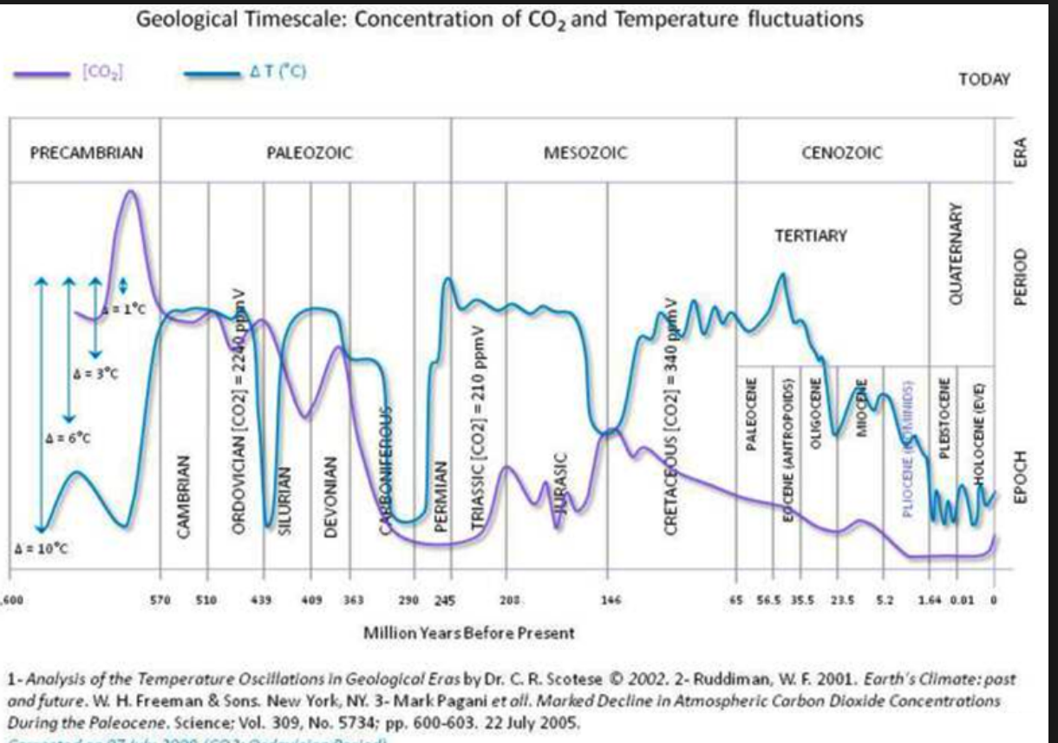
Ancient History and its Predictive Value
There is no know linkage between CO2 and temperature the entire known history of the earth.
443 M Years ago

Slide 13
Average Surface Temperatures Northern Hemisphere Last 11,000 Years
Notes:
T

Slide 16
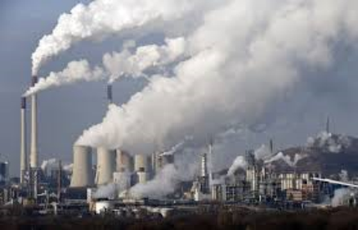
The Human Cause
Some have argued that there has been a pause in global warming.
NOAA – never stalled, just masked by incomplete data.
Temperature rate of increase during the last half of the 20th century virtually identical to that of the 21st century.
Warming from 1998-2012 was more than double the previous estimates.
Humanity is the cause of earth getting hotter primarily by burning fossil fuels and deforestation.
Notes:
There has been a long debate over what some say has been a pause in global warming.
NOAA – which has improved and expanded over recent years. We now have much better data in Asia, S. American, Africa with thousands of new weather stations and Buoys located throughout the oceans.
WARMING – and this does not include what has happened in the ARCTIC
END OF SLIDE – CASE is closed: the cause is burning of fossil fuels and deforestation

Slide 17
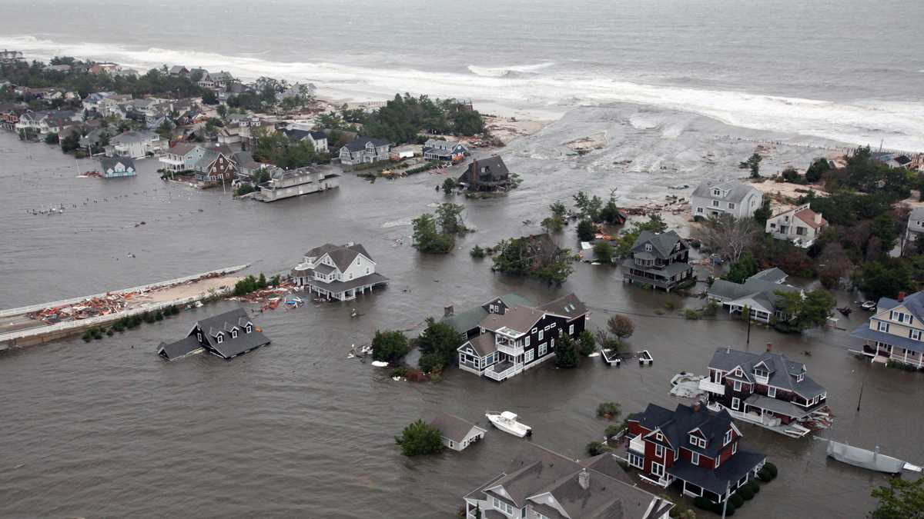
What Climate Change? Superstorm Sandy
Notes:
Natural amounts of CO2 in the air vary from 180-300 PPM. Today’s levels are around 400 ppm. That is 40% higher than the highest levels over the past 800,000 years.
We also know that CO2 comes from burning coal and oil because the chemical composition has a unique fingerprint.
Also, deforestations contributes to a lesser degree as we do not have as many trees to absorb the excess co2.
Global temperature trends were missing measurements from key locations such as Asia, South American and Africa, where measurements were scarce. Within the last 10 years, thousands of new weather stations have been built in those under-reported areas on land and a huge network of buoys have been deployed in the oceans and seas to measure sea surface temperatures. The conclusion – warming from 1998-2012 was more the double the previous estimates. What is more concerning is that these measurement do not factor in what has happened in the Arctic (at least in parts of it), where temperatures have increased rapidly in recent decades but where there are, again, a limited number of weather recording stations.

Slide 18
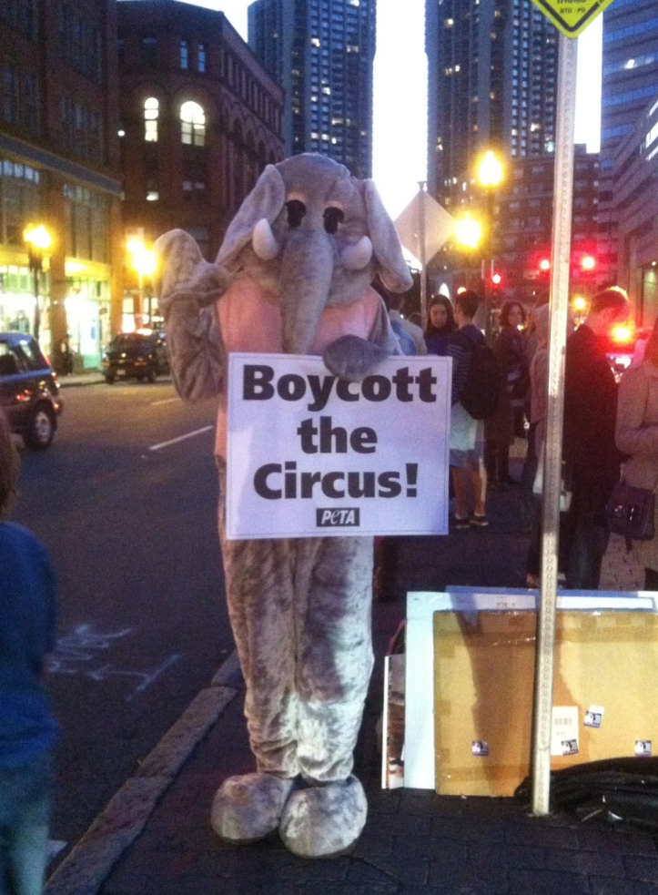
What Should be Done? 10 Suggestions
Limit power plan production.
Prioritize China’s pollution problem.
Expand carbon markets around the world.
Unleash clean energy in the US.
End fossil fuel subsidies.
Slow deforestation.
Stop methane leaks.
Cut deadly soot.
Phase our super polluting hydrofluorocarbons
(HFCs).
10. Reduce fertilizer production.

Slide 19
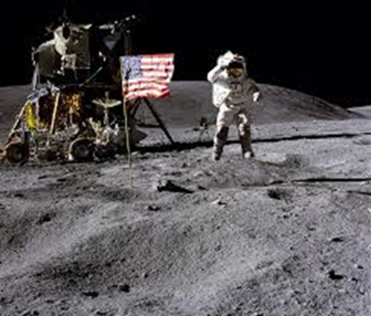
What The Question/Answer?
Not who is right or wrong!
Should we be spending time and treasure on something that will be proven by objective testing over the next few years?
What is wrong with clean air and water?

Slide 20
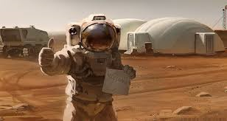
Why Not Let the Forecast Happen?
Will need the Apollo program to find another place to live.
Can’t we still improve air quality regardless?
What should the industry be doing and what is the liability for harms resulting from climate change?

Slide 21
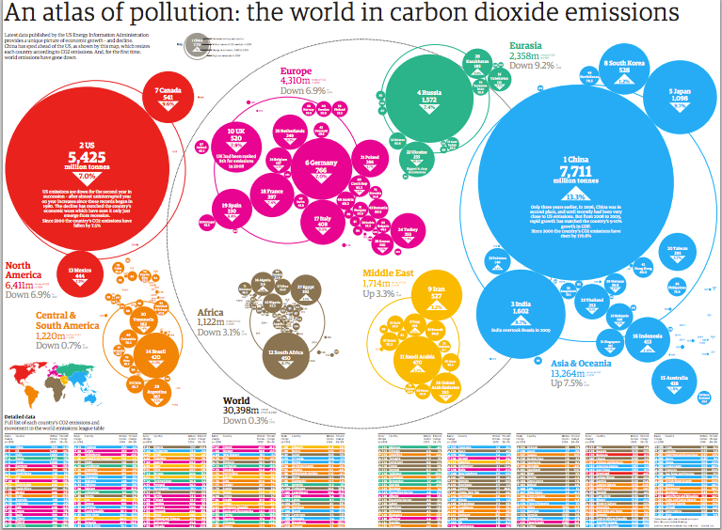
Liability for Climate Change
Standing and Political Question.
Judges barred from imposing their own limits on GHG emissions.
Clean Air Act supersedes and federal common law.
No common law claim of nuisance.

Slide 22
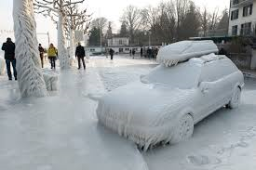
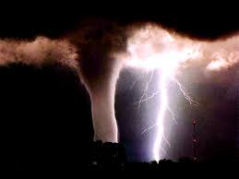
Insurance Coverage for Injury or Liability Associated with Climate Change
“Associated” not “Arising From.”
Severe or Extreme Weather Events.
Its Real and Will Lead to Increased $ for Covered Events.
No coverage for “resulting from” but there is for “associated” with climate change.
Wind, flood, freezing, heat, earth movement, collapse.

Slide 23
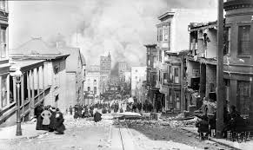
How Should the Insurance Industry Respond?
Insurance industry is uniquely qualified to understand climate change and broaden society’s awareness of it and provide solutions.
Losses from extreme events to increase by as much as 40% by end of decade.
Bad year could exceed $1 Trillion.
Duty to society and to shareholders to minimize exposure.
Historically taken the lead in minimizing risk:
Building codes for fire and earthquakes.

Slide 24
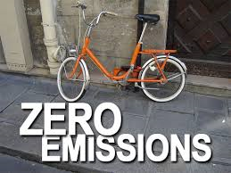
Loss Prevention Solutions
Energy Efficient Programs.
Green building designs.
Sustainable driving practices.
Carbon emission trading.
Financing mortgages for those with efficient homes or home upgrades.
Reduce their own GHG’s.

Slide 26
The Industry is Responding
Wind farms and other alternative fuels.
Emerging financial risks from carbon trading.
Protect those that invest in clean technology projects against failure to deliver agreed emission rates.
Carbon risk management consulting services.
Discounts on auto insurance for driving fewer miles.
Discounts for green building construction.
Coverage for loss of income for those that sell excess energy created from private sources.
Innovative insurance products that can become profit centers.

Slide 27
BUT: Warren Buffet
Climate change has yet to affect weather events in such a manner that would change the way his conglomerate’s insurance businesses write policies.
Weather patterns in the US have so far been “remarkably benign” despite the descent of significantly destructive forces such as Hurricane Sandy in the past.
"I have not seen anything yet that would cause me to change the way we look at evaluating quakes, tornadoes, hurricanes by atmosphere. Now, that may happen someday."

Slide 28
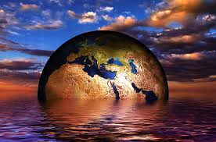
Last Thoughts
2016 probably the hottest ever on record.
More heatwaves, extreme rainfall, higher impact of tropical cyclones/hurricanes.
Arctic sea melted early and fast.
CO2 levels reached new highs.
June was 14th consecutive month of record heat for land and oceans.
378th consecutive month above 20th century average.
El Nino event of 2015 was one of the most powerful on record.
Temps in Coral Sea and Great Barrier Reef highest on record resulting in bleaching of the reef. Impacts lifetime of reefs.
Depending on where you are, you are either too wet or too dry.
Enough said.

Slide 29
THANK YOU!!

